Slide 1
Northwind Data Sales Analysis Project
About :- The Northwind database contains the sales data for a fictitious company called “Northwind Traders,” which imports and exports specialty foods from around the world. This project showcases how business insights can be derived using data analysis and visualization in Power BI.
Objective :- The purpose of this project is to provide a comprehensive view of business performance of Northwind by analyzing sales, customer behavior, inventory levels, employee productivity, shipping efficiency, and supplier contributions to support data-driven decision making.
Tools used :- Power BI, SQL, Excel.
Name :- Gaurav Kumar

Slide 2
Dataset Description
The Northwind database contains the sales data for a fictitious company called “Northwind Traders,” which imports and exports specialty foods from around the world.
Table Explanations
Customers Table
This table stores information about the company's customers. It includes fields for customer ID, company name, contact name, contact title, address, city, region, postal code, country, phone, and fax.
Employees Table
This table stores information about the company's employees. It includes fields for employee ID, last name, first name, title, title of courtesy, birth date, hire date, address, city, region, postal code, country, home phone, extension, photo, notes, reports to, and photo path.
Orders Table
This table stores information about the company's orders. It includes fields for order ID, customer ID, employee ID, order date, required date, shipped date, ship via, freight, ship name, ship address, ship city, ship region, ship postal code, and ship country.
Order Details Table
This table stores detailed information about the items within each order. It includes fields for order ID, product ID, unit price, quantity, and discount.

Slide 3
Products Table
This table stores information about the company's products. It includes fields for product ID, product name, supplier ID, category ID, quantity per unit, unit price, units in stock, units on order, reorder level, and whether the product is discontinued.
Suppliers Table
This table stores information about the company's suppliers. It includes fields for supplier ID, company name, contact name, contact title, address, city, region, postal code, country, phone, fax, and home page.
Shippers Table
This table stores information about the company's shipping companies. It includes fields for shipper ID, company name, and phone.
Categories Table
This table stores information about the product categories. It includes fields for category ID, category name, and description.

Slide 4
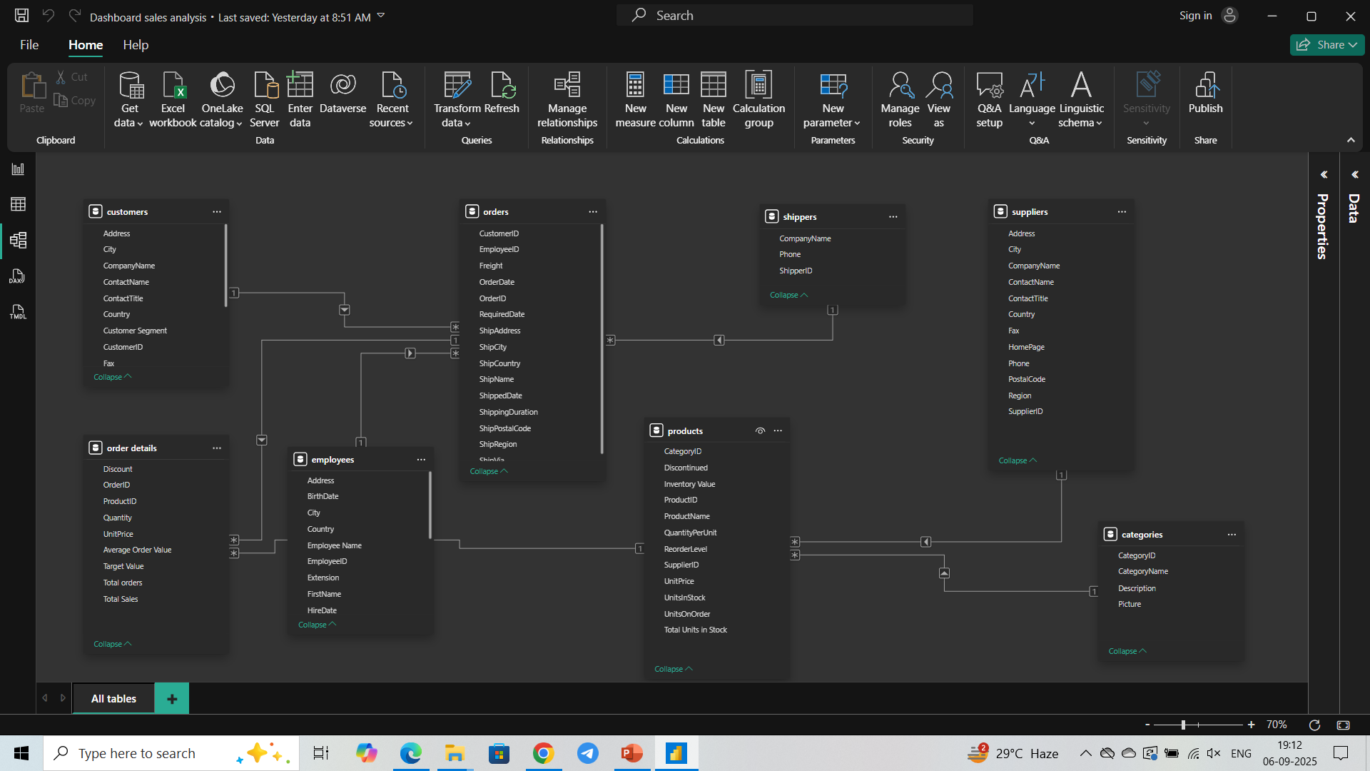
ER Diagram

Slide 5
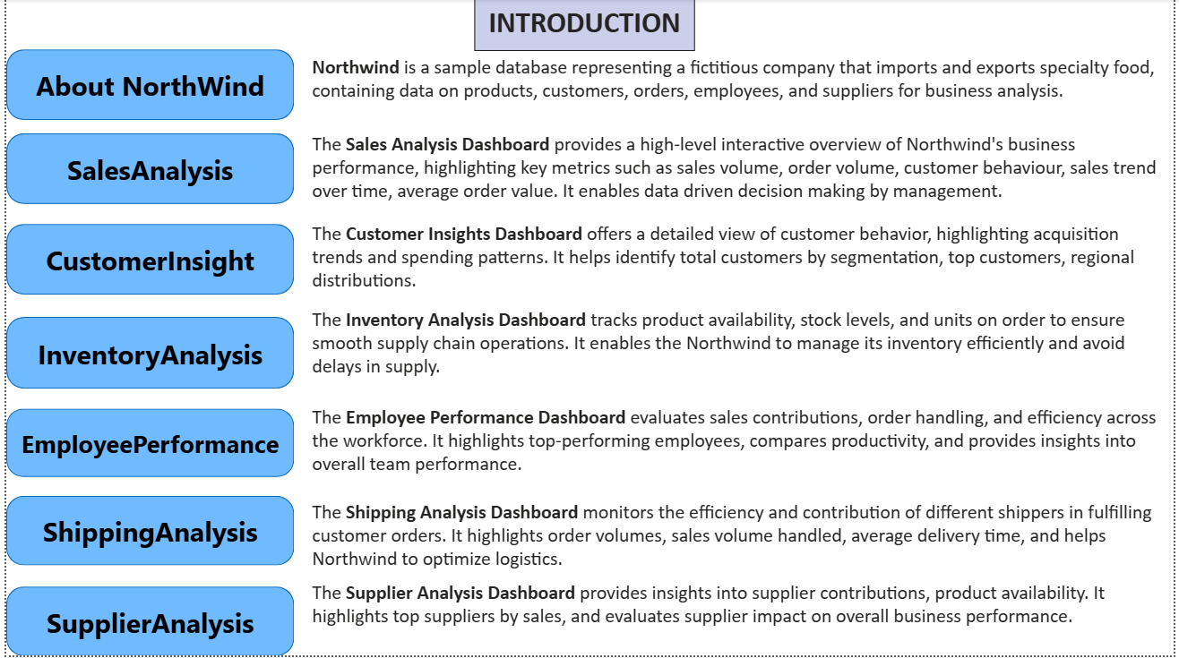

Slide 6
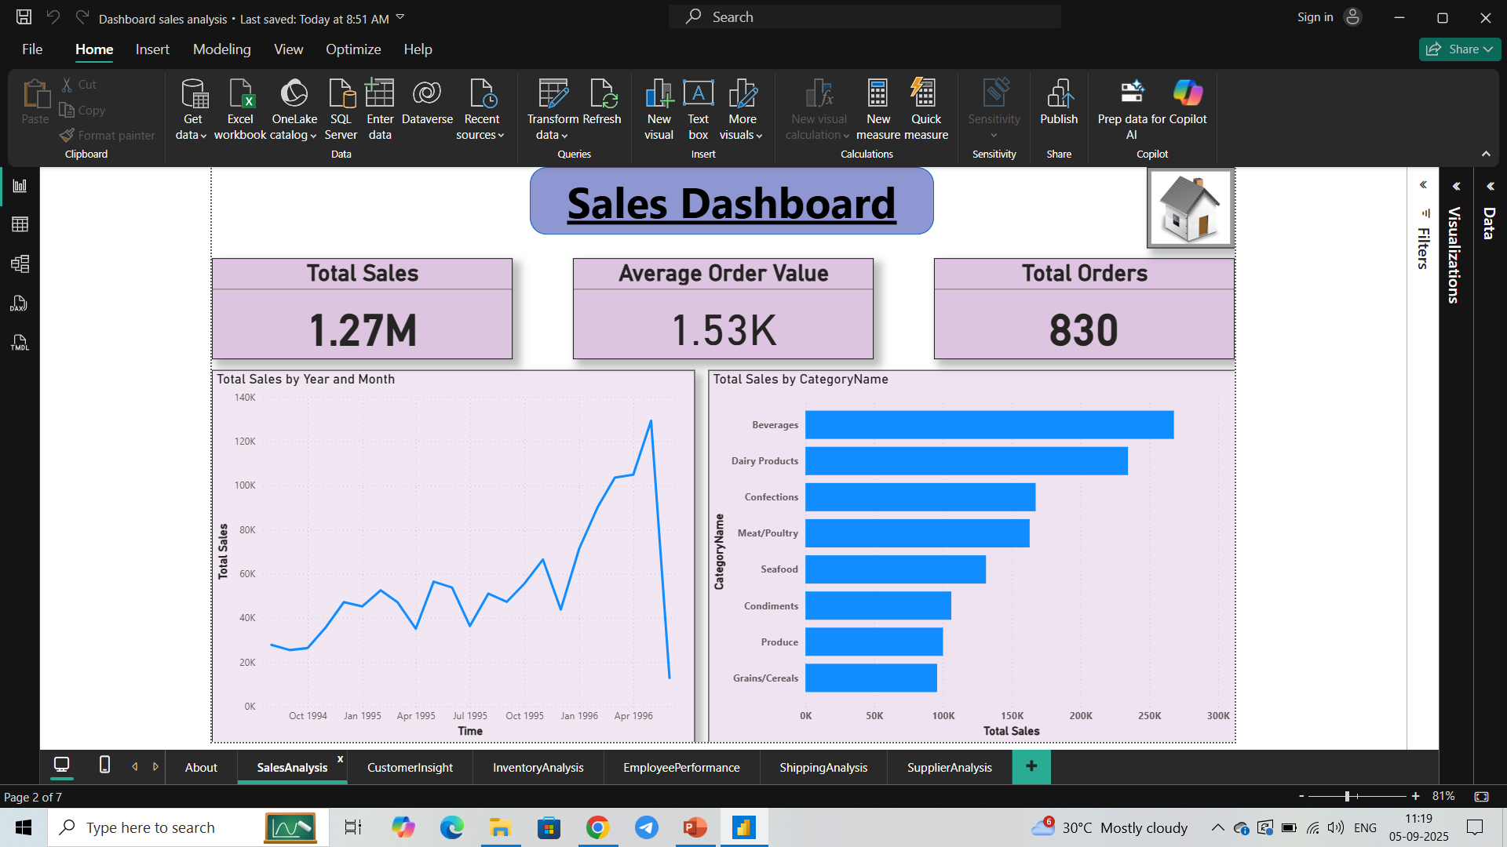
Sales Dashboard provides following insights :
Sales trend which is in increasing order.
Total Sales of different category and it states that Beverages has the highest sales.
Total Sales and Total orders along with average order value.

Slide 7
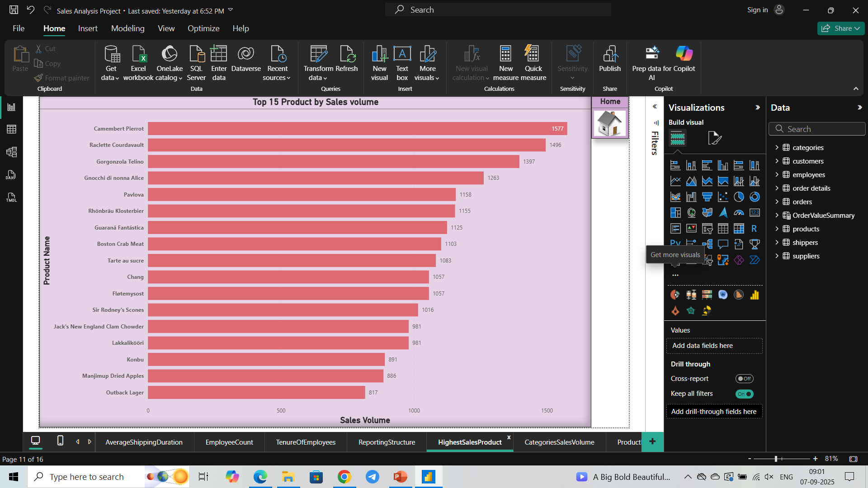
Top 15 products with the highest sales

Slide 8
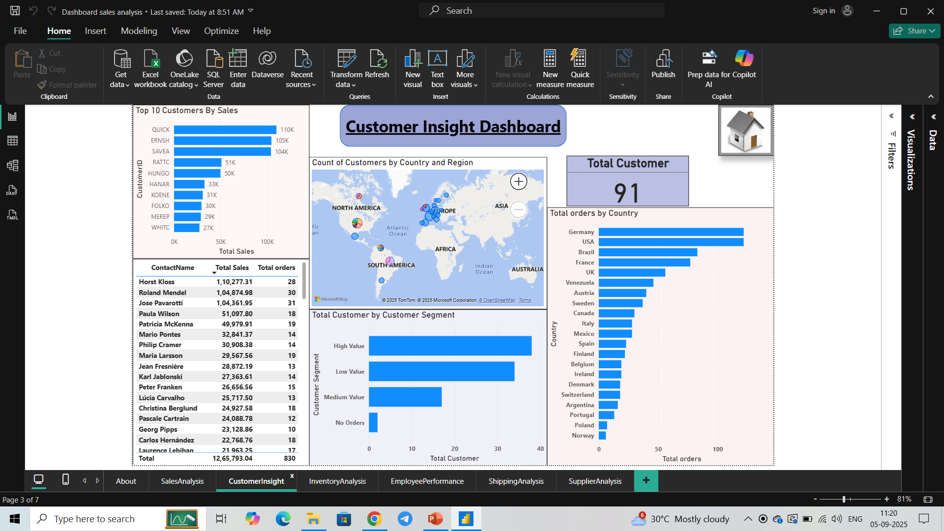
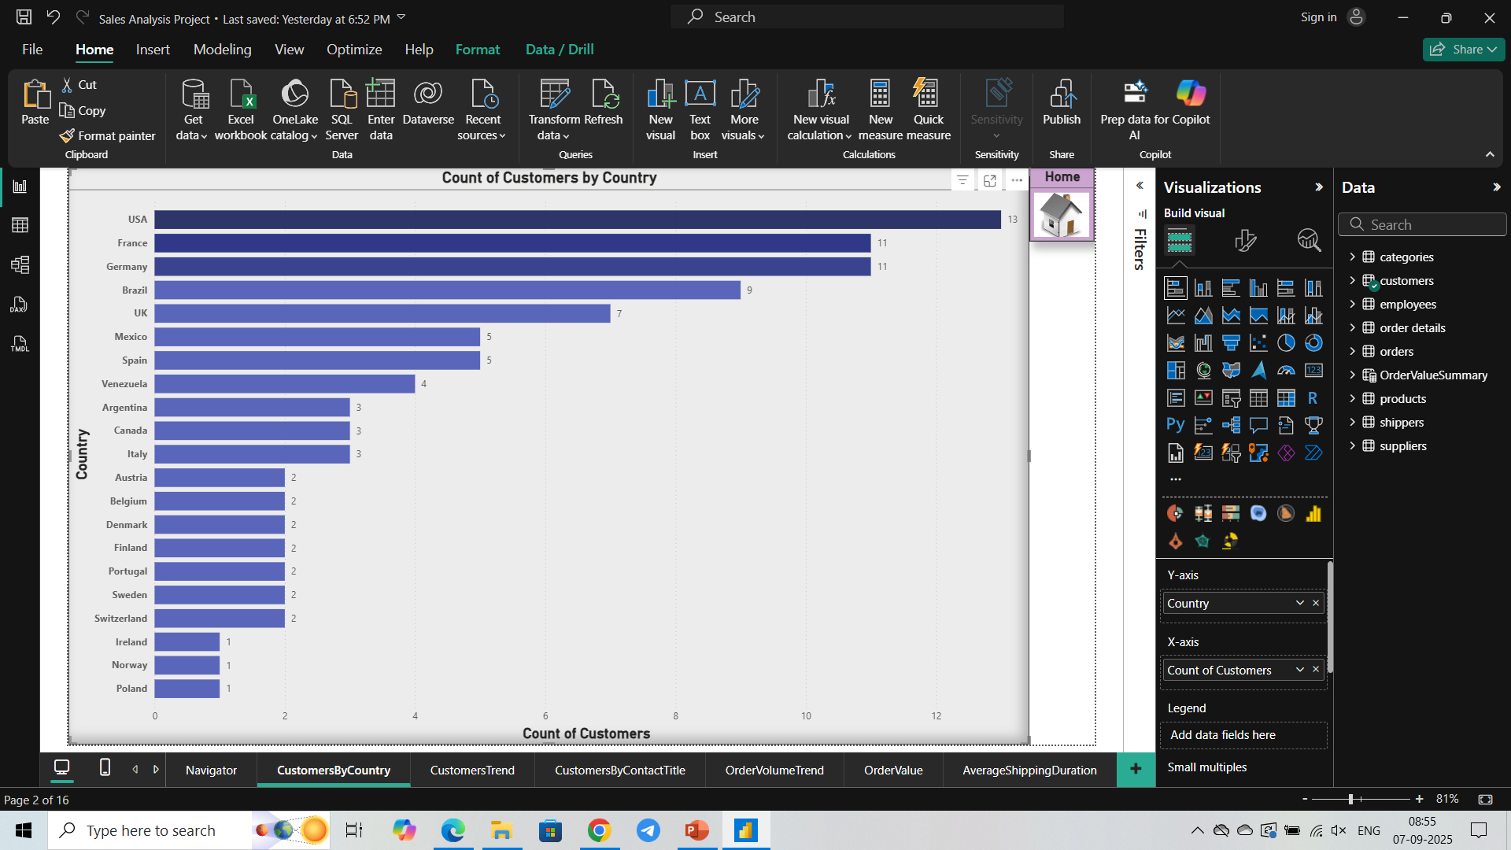
Customer Dashboard helps in understanding the customer trend and behavior like :
Dividing the customer into three segments based on their order value.
Analyzing the customers based on the Region and Country.
Top 10 Customers by their volume.
Customers name with their order and sales volume.

Slide 9
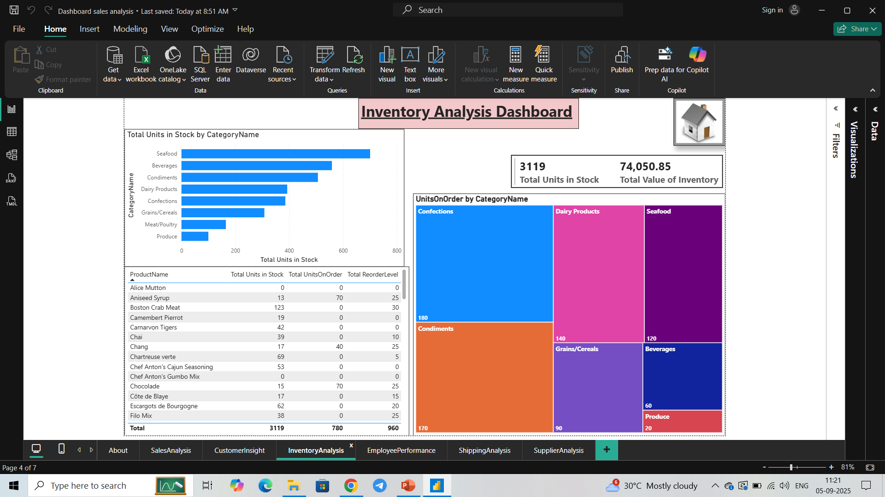
Inventory Dashboard helps in effectively maintaining the stocks level by providing following insights :
Total stocks by Category and how much company have to order.
Units on order by Category helps the company to maintain its order book.
Product name with its overall stocks analysis.

Slide 10
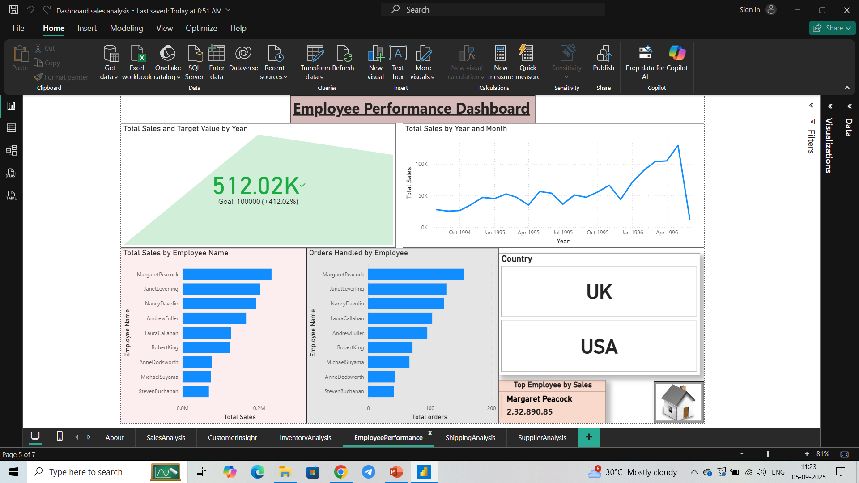
Employee Dashboard helps tracking the performance of employees by providing different insights like :
Total Sales trend over time.
Total sales by different employees and top employee by sales.
Target of sales set by company and the achieved sales value.
Orders handled by employees.
It helps in effectively manage employee performance and selecting the best performing employees.

Slide 11
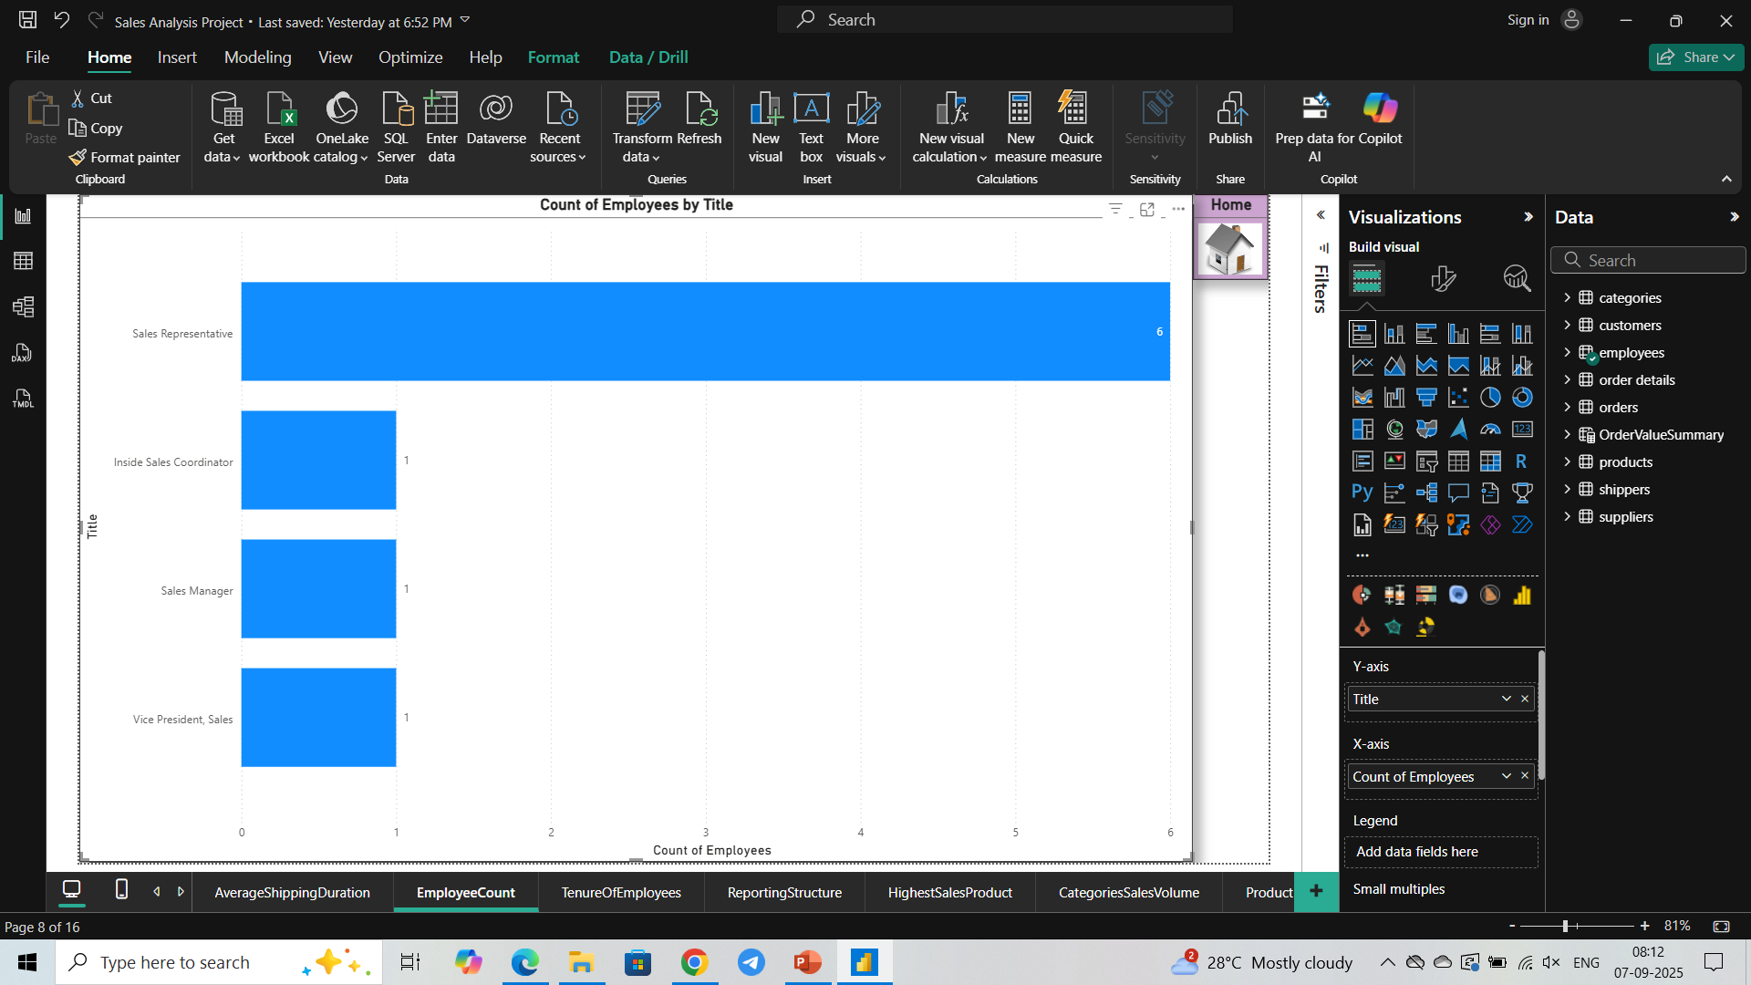
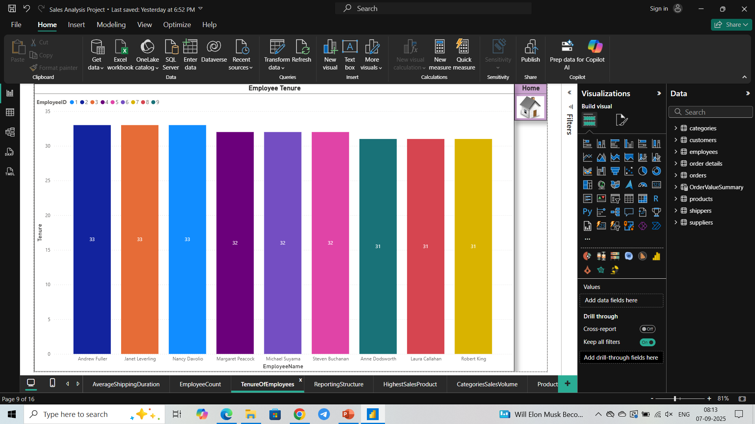
Total Count of Employees by their job title
Tenure Of Employees

Slide 12
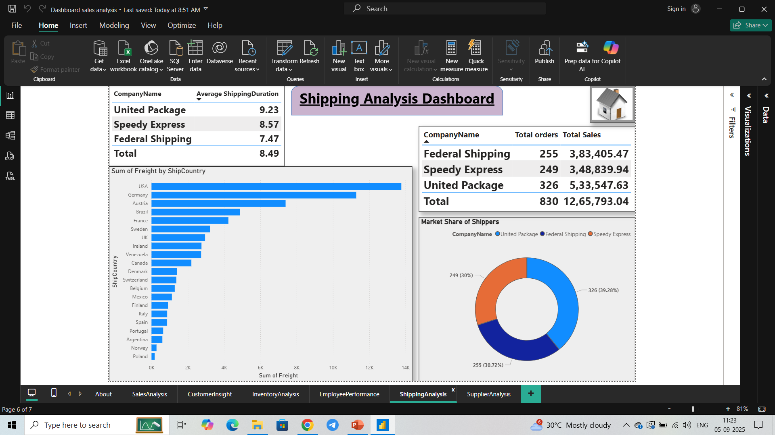
Shipping Dashboard provides details how different shipping companies are performing by providing following :
Average Shipping duration, it provides which shipping company is fastest in delivering the product.
Total orders handled by the shipping company and total sales it made.
Market share of shippers, it shows the demand of shipping company in market.
Total freight of shippers in different countries.

Slide 13
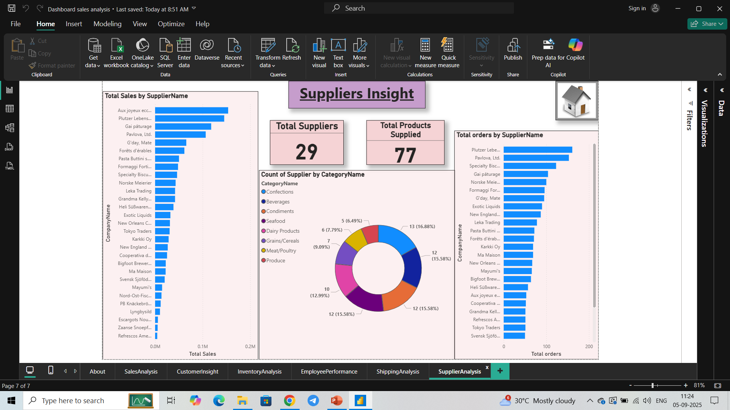
Supplier Dashboard helps in understanding about the suppliers :
Total suppliers for Northwind and the total product they supply to Northwind.
Total suppliers among different category of products.
Total sales of different suppliers.
Total orders handled by different suppliers, it provides the idea that how efficiently a supplier is managing orders.

Slide 14
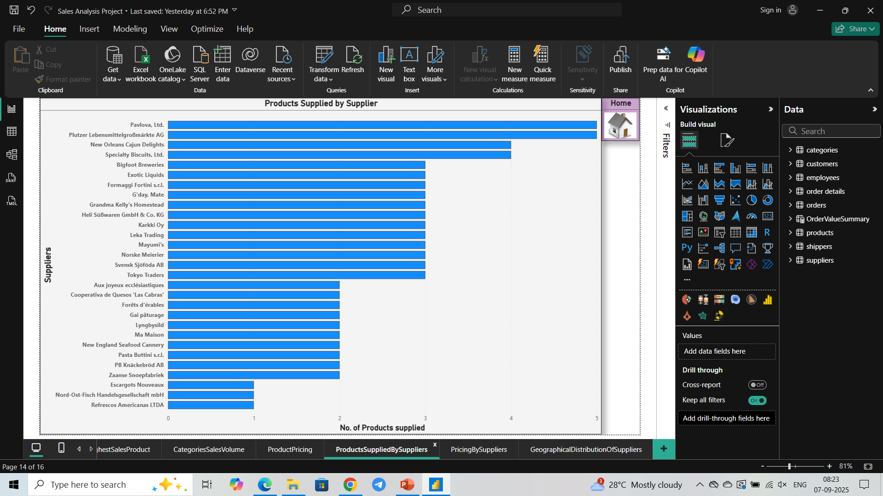
Number of different
products supplied
by Suppliers

Slide 15
Thank You

